Slide 1
LOAN MANAGEMENT SYSTEM MYSQL PROJECT – 1 B.L.dibin raj

Slide 2
SQL CONCEPTS INTRODUCTION
A brief introduction on all the concepts used in the project.

Slide 3
MYSQL INTRODUCTION
SQL (Structured Query Language) is the standard language for interacting with databases.
Used to create, read, update, and delete data (CRUD operations).
SQL Commands:
Data Definition Language (DDL): CREATE, ALTER, DROP, TRUNCATE.
Data Manipulation Language (DML): INSERT, UPDATE, DELETE.
Data Query Language (DQL): SELECT, Aggregate Functions (SUM< MIN, MAX, AVG, COUNT).
Data Control Language (DCL): GRANT, REVOKE.
Transaction Control Language (TCL): COMMIT, ROLLBACK.

Slide 4
FUNCTIONS AND AGGREGATIONS
Functions are Predefined operations in SQL used to perform calculations or manipulations.
Types of Functions:
Aggregate Functions: COUNT(), MAX(), MIN(), SUM(), AVG()
Scalar Functions: UCASE(), LCASE()
Window Functions: OVER(), RANK(), ROW_NUMBER()
Use in the Project:
Calculating interest amounts: monthly interest amount and yearly interest amount.

Slide 5
CASE END STATEMENTS
A conditional expression used in SQL to perform different actions based on conditions.
Functions like an IF-ELSE block.
Use in the Project:
Income Criteria Classification: Used to categorize customers based on their income.
Interest Rate Calculation:
Determines the monthly interest rate based on customer income and property area.

Slide 6
SQL JOINS
Joins are used to combine data from multiple tables based on a related column between them.
Types of Joins:
INNER JOIN: Returns only matching rows from both tables.
LEFT JOIN: Returns all rows from the left table, with matching rows from the right.
RIGHT JOIN: Returns all rows from the right table, with matching rows from the left.
FULL OUTER JOIN: Returns all rows when there is a match in either table.
Use in the Project:
Customer Loan Data Join: Combines customer details, loan information, and interest data.
Region Mismatch Join: Identifies region discrepancies by joining region and customer data.

Slide 7
STORED PROCEDURES
Stored Procedures:
A stored procedure is a set of SQL statements that can be executed as a single unit.
They help in modularizing and reusing code.
Benefits:
Improves performance as SQL code is precompiled.
Ensures consistency and security in operations.
Use in the Project:
Final outputs procedure: Generates multiple output datasets in one procedure call.

Slide 8
TRIGGERS
Triggers are automated actions executed by certain events, such as INSERT, UPDATE, or DELETE.
Can be BEFORE or AFTER the specified event.
TYPES OF TRIGGERS:
ROW LEVEL TRIGGER
COLUMN LEVEL TRIGGER
Use in the Project:
Loan Status Trigger: Automatically sets the loan status to "LOAN STILL PROCESSING" if the loan amount is not provided.
CIBIL Score Trigger: Inserts customer data into CIBIL score info based on CIBIL score.

Slide 9
PROJECT IMPLEMENTATION

Slide 10
CUSTOMER INCOME CLASSIFICATION
In this section, we classify customers based on their income into different grades.
Criteria:
>15,000: Grade A Customer.
>9,000: Grade B Customer.
>5,000: Middle Class Customer.
<= 5,000: Low Class Customer.
Source Table: customer income.
Result table: customer income criteria.

Slide 11
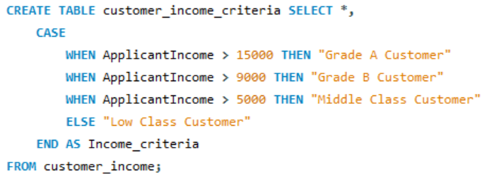
CUSTOMER INCOME CLASSIFICATION

Slide 12
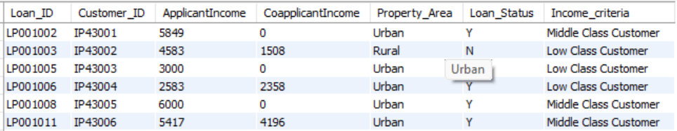
CUSTOMER INCOME CLASSIFICATION (Output)

Slide 13
MONTHLY INTEREST PERCENTAGE
Calculate interest percentage based on income and property area.
Interest Rates:
Applicant Income < 5000:
Rural: 3%
Semi-rural: 3.5%
Urban: 5%
Semi-urban: 2.5%
Otherwise: 7%
Source Table: customer income criteria.
Result Table: monthly interest table.

Slide 14
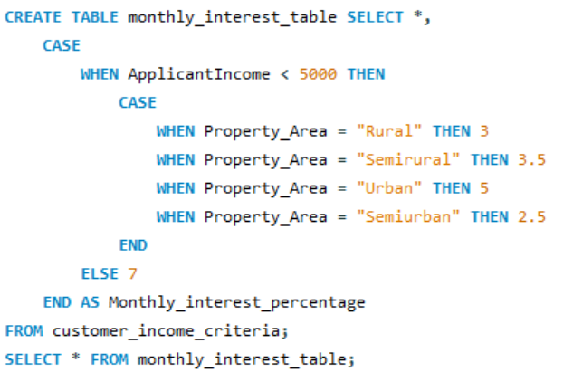
MONTHLY INTEREST PERCENTAGE

Slide 15
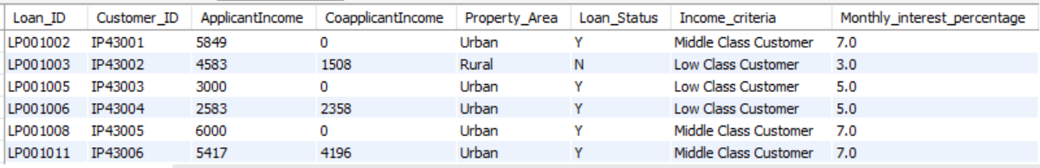
MONTHLY INTEREST PERCENTAGE (Output)

Slide 16
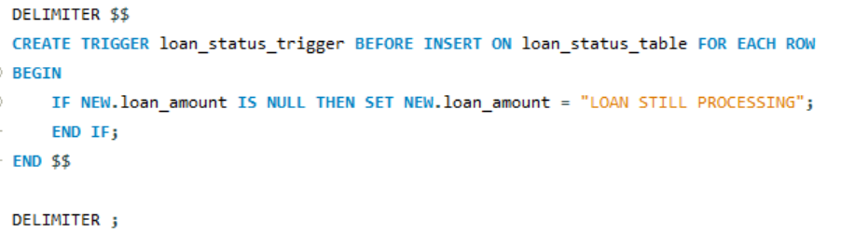
LOAN STATUS TRIGGER
Automatically update the loan amount field with "LOAN STILL PROCESSING" if loan amount value is null.

Slide 17
CIBIL SCORE STATUS TRIGGER
Using trigger to Insert data based on CIBIL score into CIBIL score info.
Criteria:
CIBIL Score > 900: "HIGH CIBIL SCORE"
CIBIL Score > 750: "NO PENALTY"
CIBIL Score ≥ 0: "PENALTY CUSTOMERS"
Otherwise: "REJECTED CUSTOMERS“
Result Table: CIBIL score info.

Slide 18
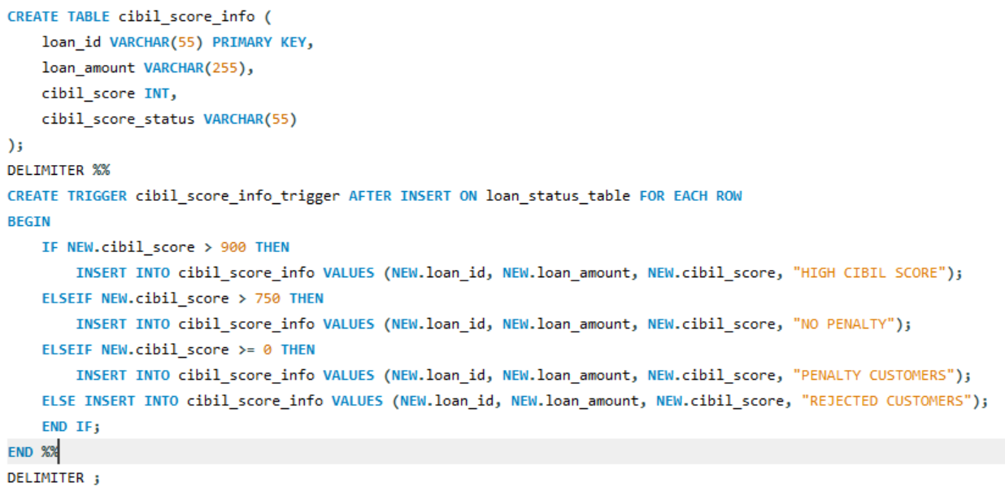
CIBIL SCORE STATUS TRIGGER

Slide 19
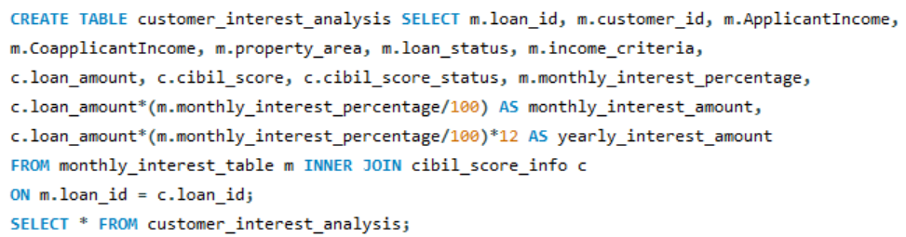
CUSTOMER INTEREST ANALYSIS
Combining the monthly interest table and CIBIL score info table for analysis.

Slide 20
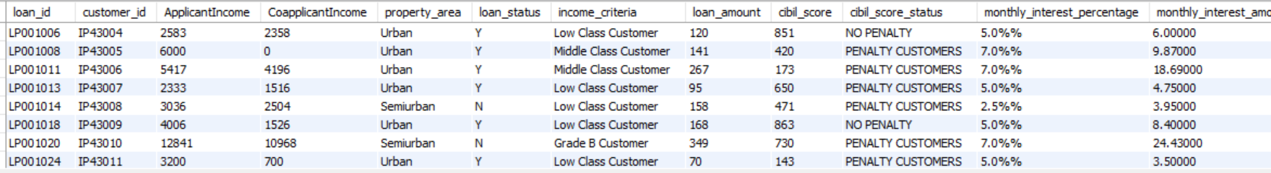
CUSTOMER INTEREST ANALYSIS (Output)

Slide 21
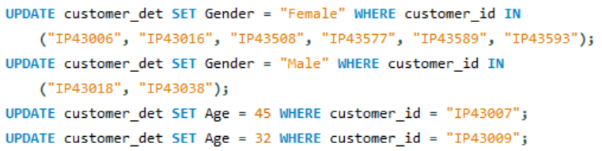
CUSTOMER DETAILS UPDATE
Update customer gender and age based on customer id.

Slide 22
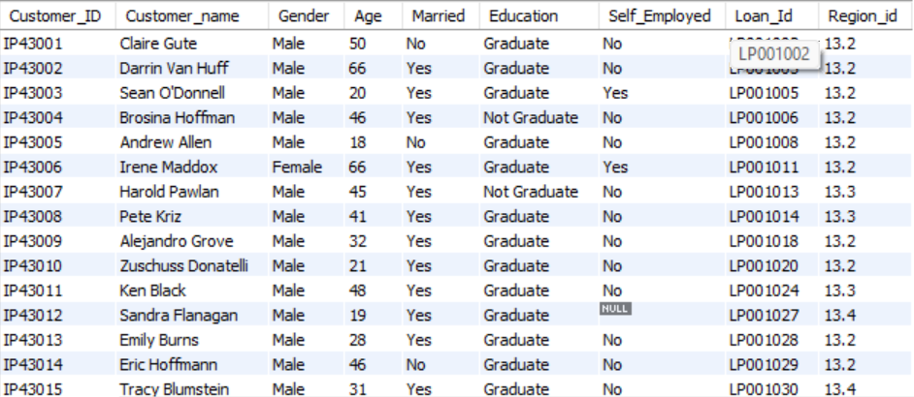
CUSTOMER DETAILS UPDATE (Output)

Slide 23
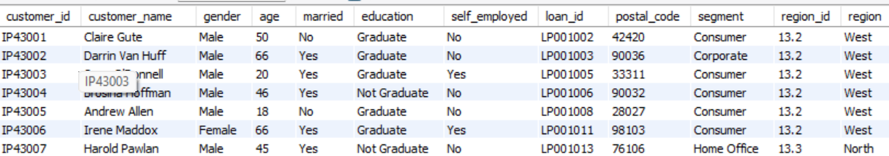
CUSTOMER INFO AND LOAN JOIN
Combining 3 tables to calculate the final output.
Output

Slide 24
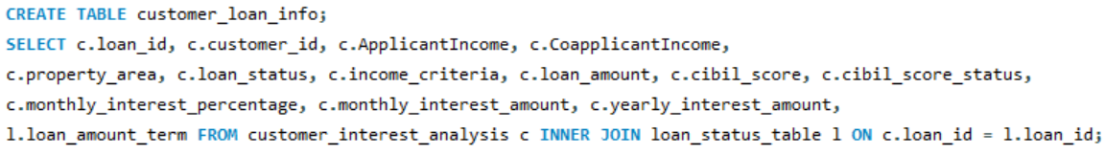
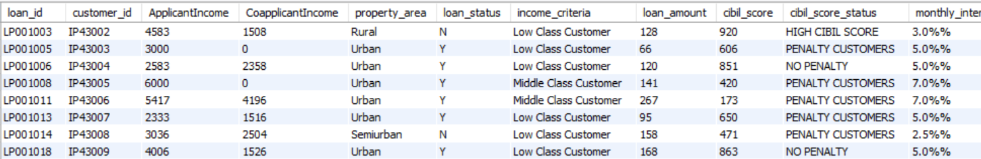
CUSTOMER INFO AND LOAN JOIN
Combining 2 tables to calculate the final output.
Output

Slide 25
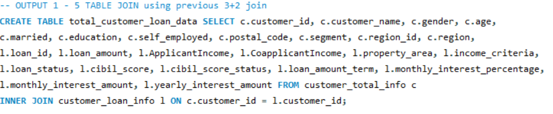
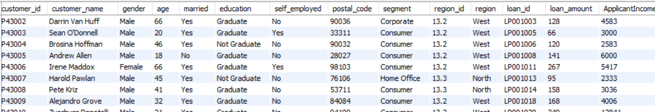
TOTAL CUSTOMER LOAN DATA
Joining the previously calculated two tables customer total info and customer loan info.
Output

Slide 26
REGION MISMATCH TABLE
Identify mismatches between customer regions and recorded region info.
Output

Slide 27
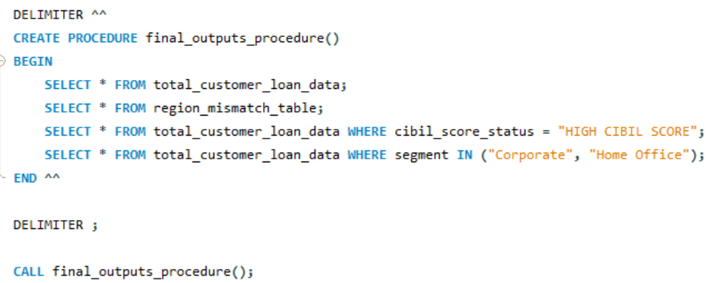
FINAL OUTPUT – STORED PROCEDURE
Creating a stored procedure to produce the required output tables.

Slide 28
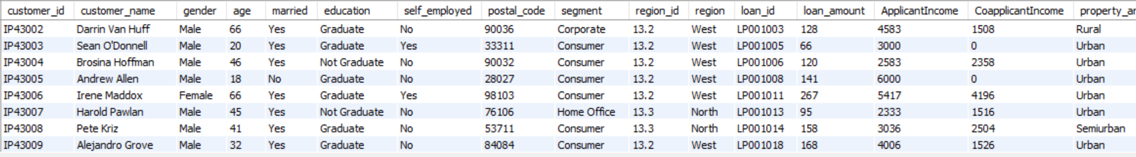
FINAL OUTPUT – STORED PROCEDURE
Total Customer Loan Data:
Output

Slide 29
FINAL OUTPUT – STORED PROCEDURE
Region Mismatch Table:
Output

Slide 30
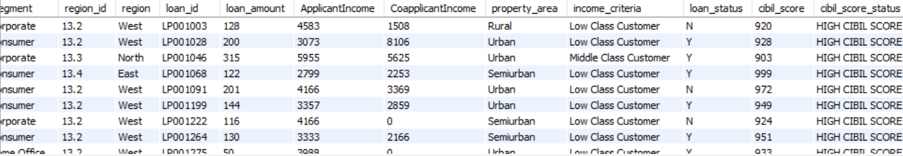
FINAL OUTPUT – STORED PROCEDURE
HIGH CIBIL SCORE customers:
Output

Slide 31
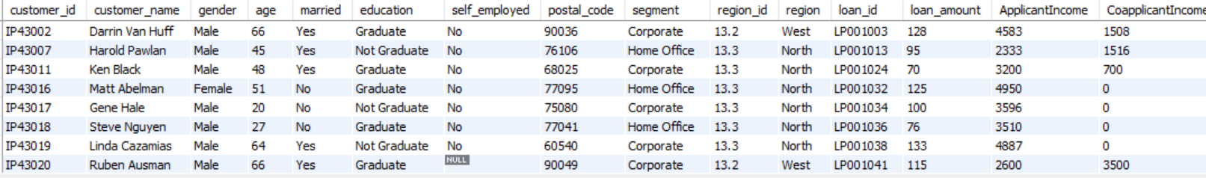
FINAL OUTPUT – STORED PROCEDURE
Customers in Corporate and Home Office segments:
Output

Slide 32
Thank you

